Slide 1

Unit Outline
Year 7 Drama

Slide 2
Fairy Tale Meltdown:
Exploring the Elements of Drama
Global Context | Exploration
Personal and Cultural Expression | Artistry
Think - Pair - Share
What are different forms of cultural expression?
Where there any that surprised you?
What is Artistry?

Slide 3
Fairy Tale Meltdown:
Exploring the Elements of Drama
Key Concept | Related Concepts
Communication | Structure Audience
Post-it Brainstorm (4 per student)
What is Communication?
What are the different forms of Communication?

Slide 4
Fairy Tale Meltdown:
Exploring the Elements of Drama
Key Concept | Related Concepts
Communication | Structure Audience
Non-Volunteer
Why is structure important in real life?
Why is structure important in drama/performance?

Slide 5
Fairy Tale Meltdown:
Exploring the Elements of Drama
Key Concept | Related Concepts
Communication | Structure Audience
Think - Pair - Share
What different types of audiences are there?
How might an audience influence or change a performance?

Slide 6
Fairy Tale Meltdown:
Exploring the Elements of Drama
Statement of Inquiry
Cherished narratives communicate with and inspire audiences through the manipulation of structure, serving as a catalyst for generating fresh artistic endeavours.
Guided Discussion
What do you think the Statement of Inquiry is asking of you?

Slide 7
Approaches to Learning
ATL Skills

Slide 8
Approaches To Learning
There are many different ways to learn – different approaches are good for different people or different situations.
Brainstorm activity (3 mins)
Do you agree with this?
Can you think of any examples?

Slide 9
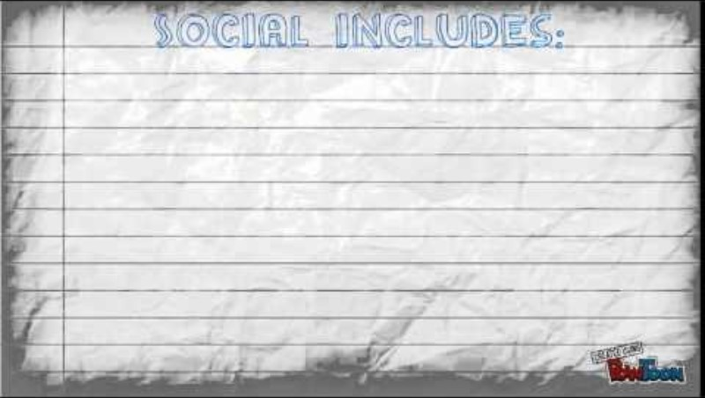
Approaches To Learning

Slide 10
5 ATL Categories
Communication
Social
Thinking
Self-Management
Research

Slide 11
SELF MANAGEMENT
Organizational Skills:
Bring the necessary equipment and supplies to class.
Whiteboard activity (1 min)
Using your whiteboard write down 3 items you should be bringing to Drama.
Do they need to be physical items?

Slide 12
SELF MANAGEMENT
Organizational Skills:
Bring the necessary equipment and supplies to class.
Discussion:
Why are these skills important in Drama and in real life?

Slide 13
THINKING
Creative Thinking Skills:
Create original works, use existing works in new ways.
Brainstorm activity (3 mins)
Do you agree with this?
Can you think of any examples?

Slide 14
Approaches To Learning
In order to explore ideas and inform the development of your performance, you need to bring the necessary equipment and supplies to class.
Create original works and utilize existing works in new ways, while presenting a clear artistic intention for the final artwork performance of your Twisted Fairytale.
Guided Discussion
How will these ATLs help me to succeed in Drama this term?

