Slide 1


DAILY REVIEW
The Elements of Drama

Slide 2

- Element of Drama -
FOCUS
Focus is the frame directing the attention of the audience & between performers.
It is also the concentration and belief of the performer.

Slide 3
- Element of Drama -
Focus
_____ is the frame directing the attention of the audience & between performers.
It is also the concentration and belief of the performer.

Slide 4
- Element of Drama -
FOCUS
Focus is the frame directing the attention of the audience & between performers.
It is also the concentration and belief of the performer.

Slide 5
- Element of Drama -
FOCUS
Focus is the frame directing the attention of the _______ & between _________.
It is also the concentration and belief of the performer.
audience
performers

Slide 6
- Element of Drama -
FOCUS
Focus is the frame directing the attention of the audience & between performers.
It is also the concentration and belief of the performer.

Slide 7
- Element of Drama -
FOCUS
Focus is the frame directing the attention of the audience & between performers.
It is also the concentration and ____ of the performer.

Slide 8
- Element of Drama -
FOCUS
Focus is the frame directing the attention of the audience & between performers.
It is also the concentration and belief of the performer.

Slide 9
- Element of Drama -
FOCUS
Which Element of Drama is the frame directing the attention of the audience & between performers?
It is also the concentration and belief of the performer.

Slide 10
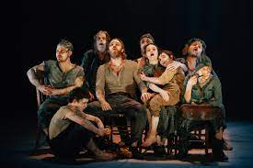
- Element of Drama -
MOOD
Mood is the overall feeling or emotion that a performance may evoke.

Slide 11
- Element of Drama –
____ is the overall feeling or emotion that a performance may evoke.

Slide 12
- Element of Drama -
MOOD
Mood is the overall feeling or emotion that a performance may evoke.

Slide 13
- Element of Drama -
MOOD
Mood is the overall feeling or _____ that a performance may evoke.

Slide 14
- Element of Drama -
MOOD
Mood is the overall feeling or emotion that a performance may evoke.

Slide 15
- Element of Drama -
MOOD
Which Element of Drama is the overall feeling or emotion that a performance may evoke.

Slide 16
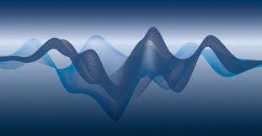
- Elements of Drama -
SOUND
Sound can enhance the performance by building tension.

Slide 17
- Elements of Drama -
_____ can enhance the performance by building tension?

Slide 18
- Elements of Drama -
SOUND
Sound can enhance the performance by building tension.

Slide 19
- Elements of Drama –
SOUND
Sound can enhance the performance by building ______?

Slide 20
- Elements of Drama -
SOUND
Sound can enhance the performance by building tension.

Slide 21
- Elements of Drama -
SOUND
Which Element of Drama can enhance the performance by building tension?

Slide 22
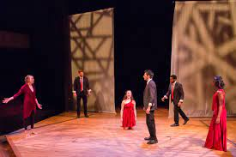
- Element of Drama -
SPACE
Space is the way the performance area is used to communicate meaning.

Slide 23
- Element of Drama -
_____ is the way the performance area is used to communicate meaning.

Slide 24
- Element of Drama -
SPACE
Space is the way the performance area is used to communicate meaning.

Slide 25
- Element of Drama -
SPACE
Space is the way the performance area is used to communicate ________.

Slide 26
- Element of Drama -
SPACE
Space is the way the performance area is used to communicate meaning.

Slide 27
- Element of Drama -
SPACE
Which Element of Drama refers to the way the performance area is used to communicate meaning.

Slide 28
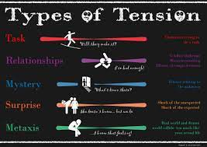
- Element of Drama -
TENSION
Tension is the suspense that holds an audience’s attention as a performance unfolds.
The release of tension may have a comic or a dramatic effect.

Slide 29
- Element of Drama -
_______ is the suspense that holds an audience’s attention as a performance unfolds.

Slide 30
- Element of Drama -
TENSION
Tension is the suspense that holds an audience’s attention as a performance unfolds.

Slide 31
- Element of Drama -
TENSION
Tension is the _______ that holds an audience’s attention as a performance unfolds.

Slide 32
- Element of Drama -
The release of ______ may have a comic or a dramatic effect.

Slide 33
- Element of Drama -
TENSION
The release of tension may have a comic or a dramatic effect.

Slide 34
- Element of Drama -
TENSION
The release of tension may have a comic or a ______ effect.

Slide 35
- Element of Drama -
TENSION
The release of tension may have a comic or a dramatic effect.

Slide 36
- Element of Drama –
TENSION
Which Element of Drama is the suspense that holds an audience’s attention as a performance unfolds.
And its release may have a comic or a dramatic effect.

Slide 37
Dramatic Meaning
The meaning created through all of the elements combined.

Slide 38
Dramatic Meaning
The meaning created through all of the ________ combined.

Slide 39
Dramatic Meaning
The meaning created through all of the elements combined.

Slide 40
Dramatic Meaning
What is created through all of the elements combined?

Slide 41
3 2 1…

